Slide 1
nghbrly
Mobile App Focused on Fostering Neighbor to Neighbor Interactions
Team Brook: Andrew Brook

Slide 2

Team Brook:
Andrew Brook
Designer
Developer
Bug Fixer
Documenter

Slide 3
pronounced: neighborly
nghbrly is a mobile app thats focus is to provide an easy way for neighbors to both ask for help as well as provide help
nghbrly

Slide 4
Details
IDE: Microsoft Visual Studio Code
Language: React-Native and JS
Version controal: Git/Git-Hub
Database: Firebase Firestore
Authentication api: Firebase Auth

Slide 5
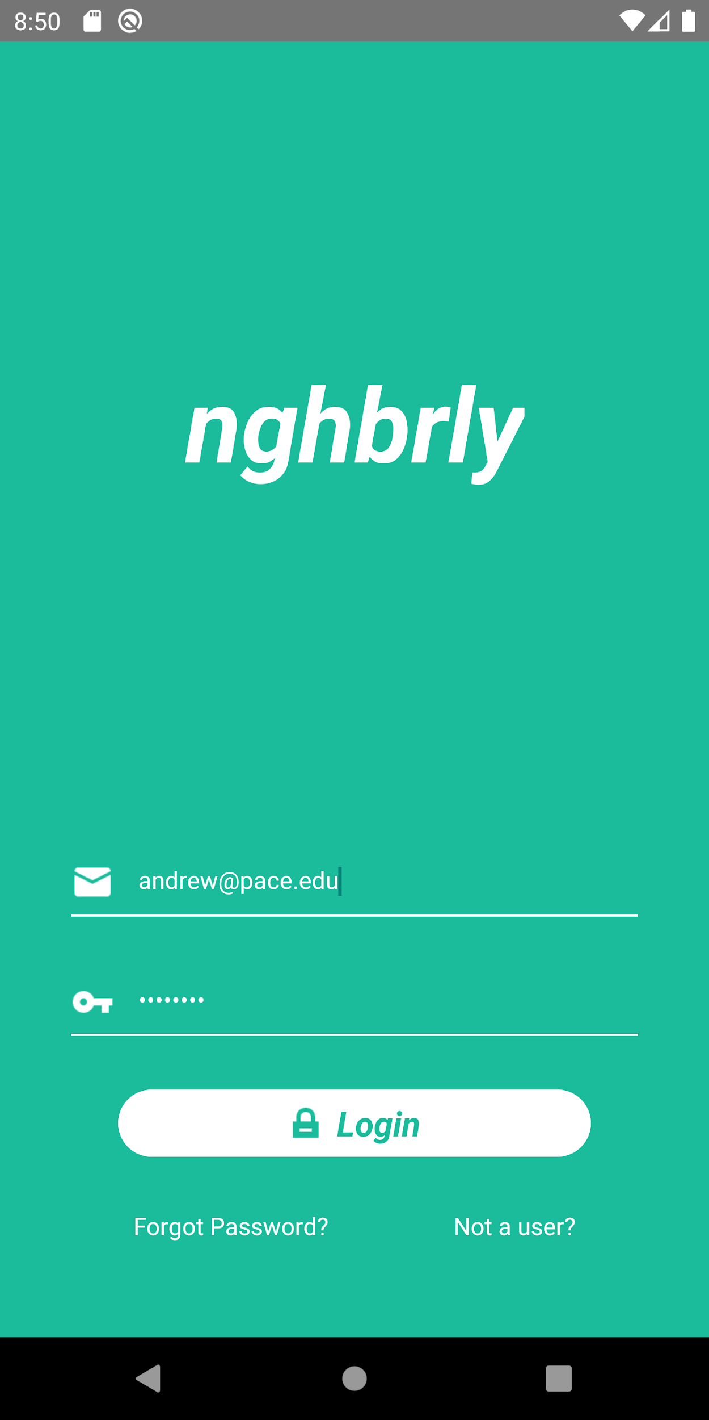
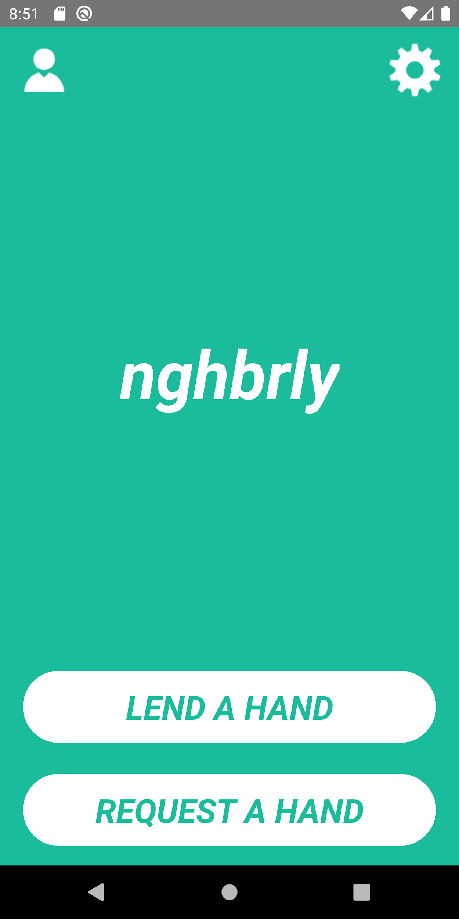
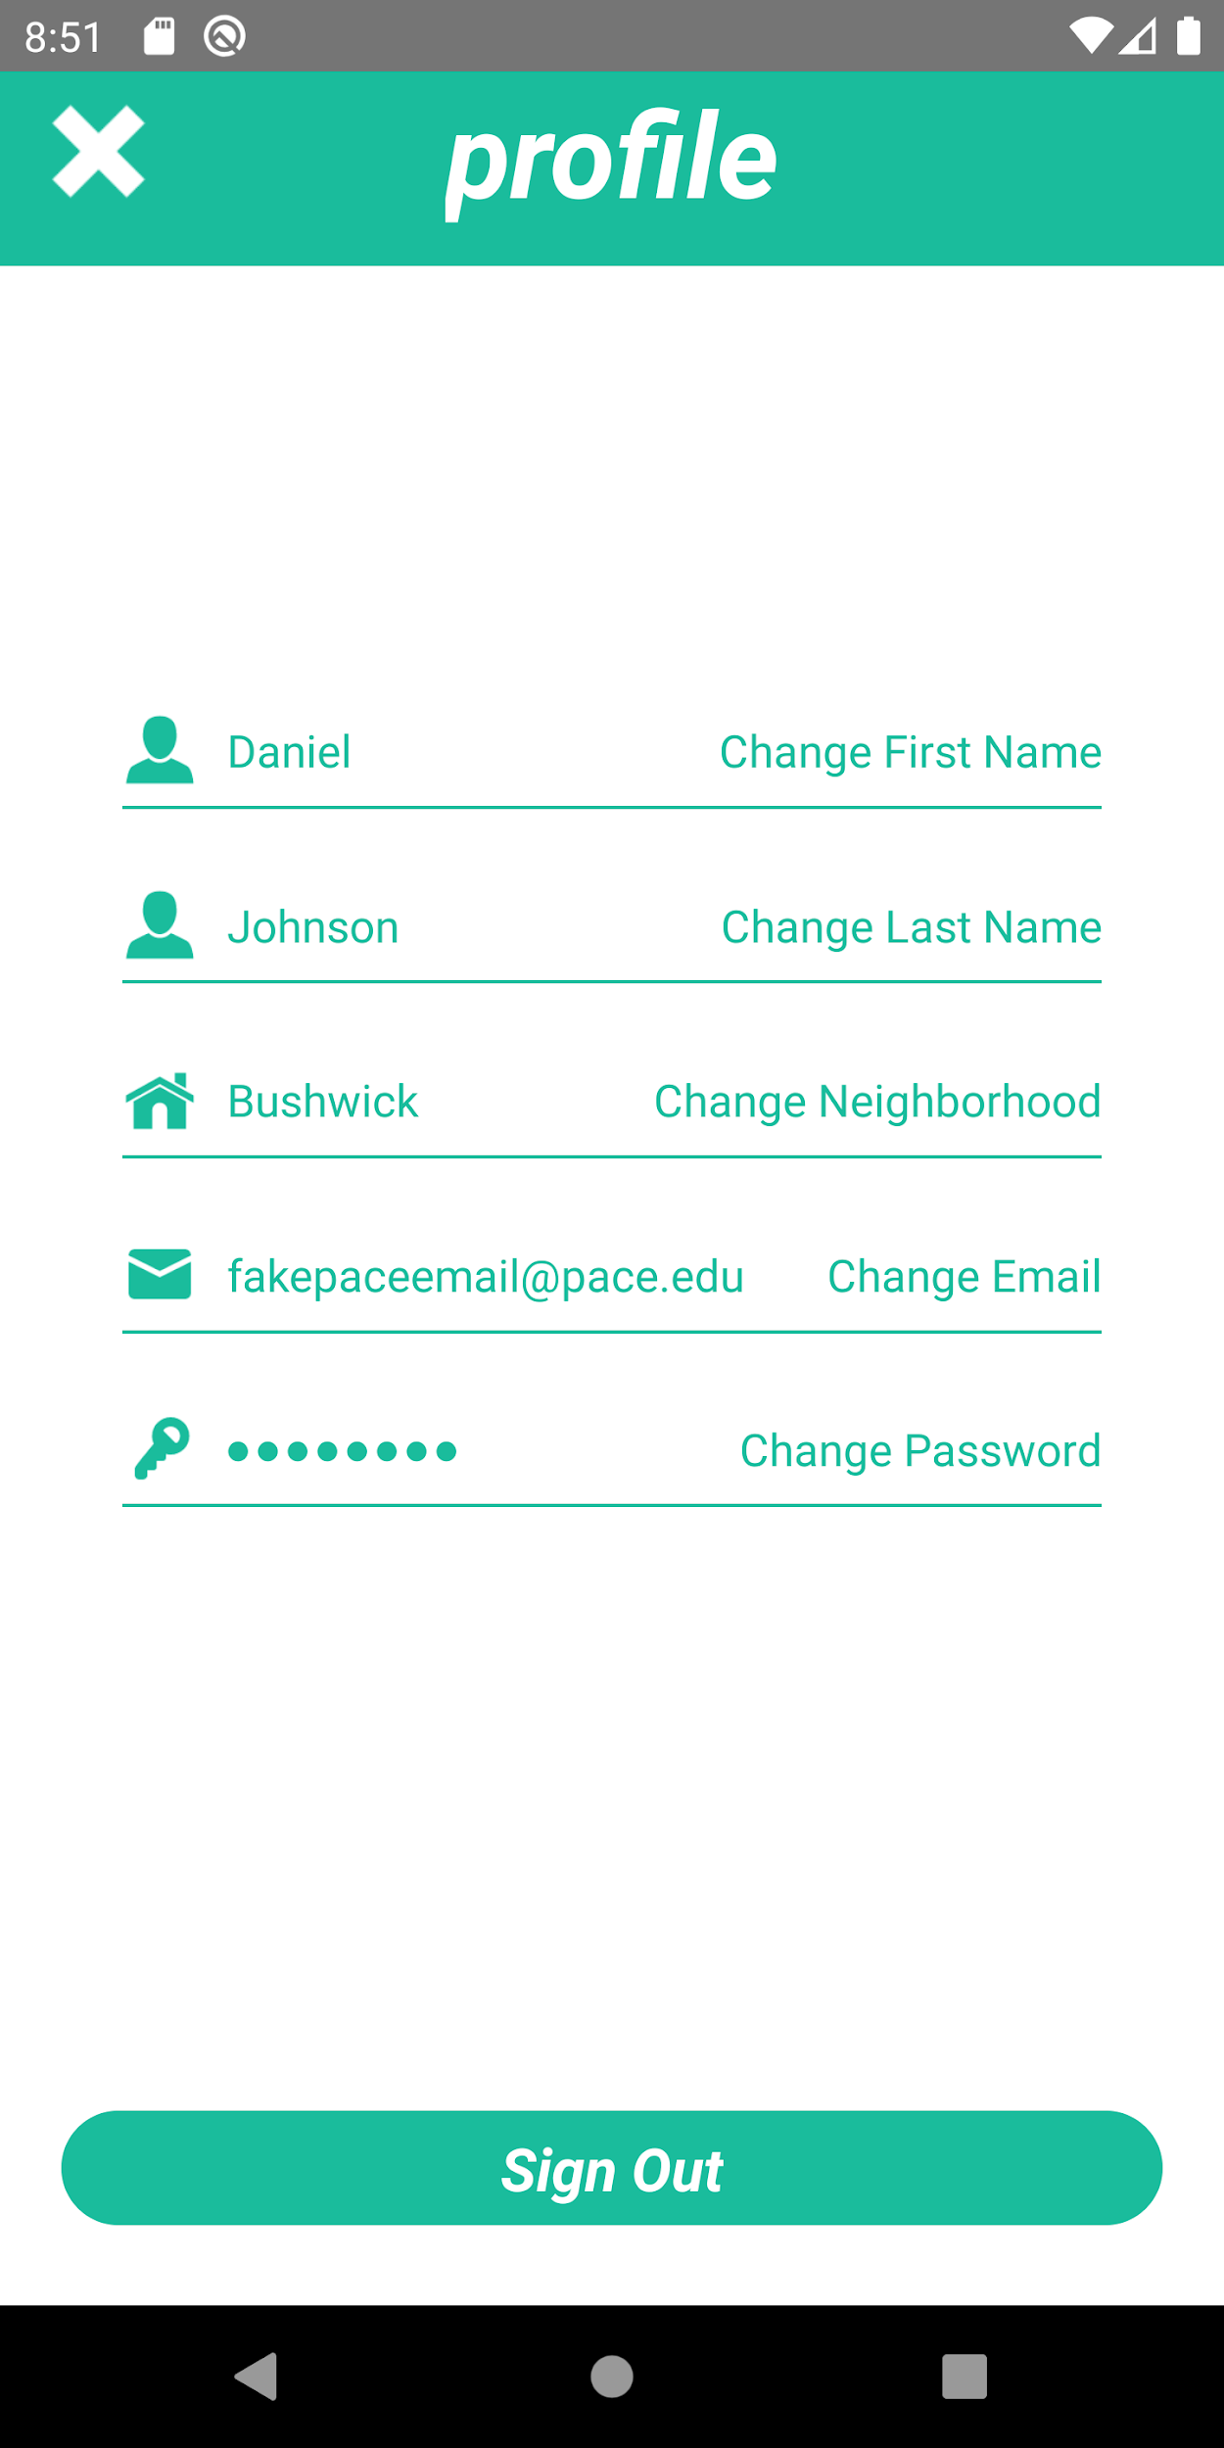
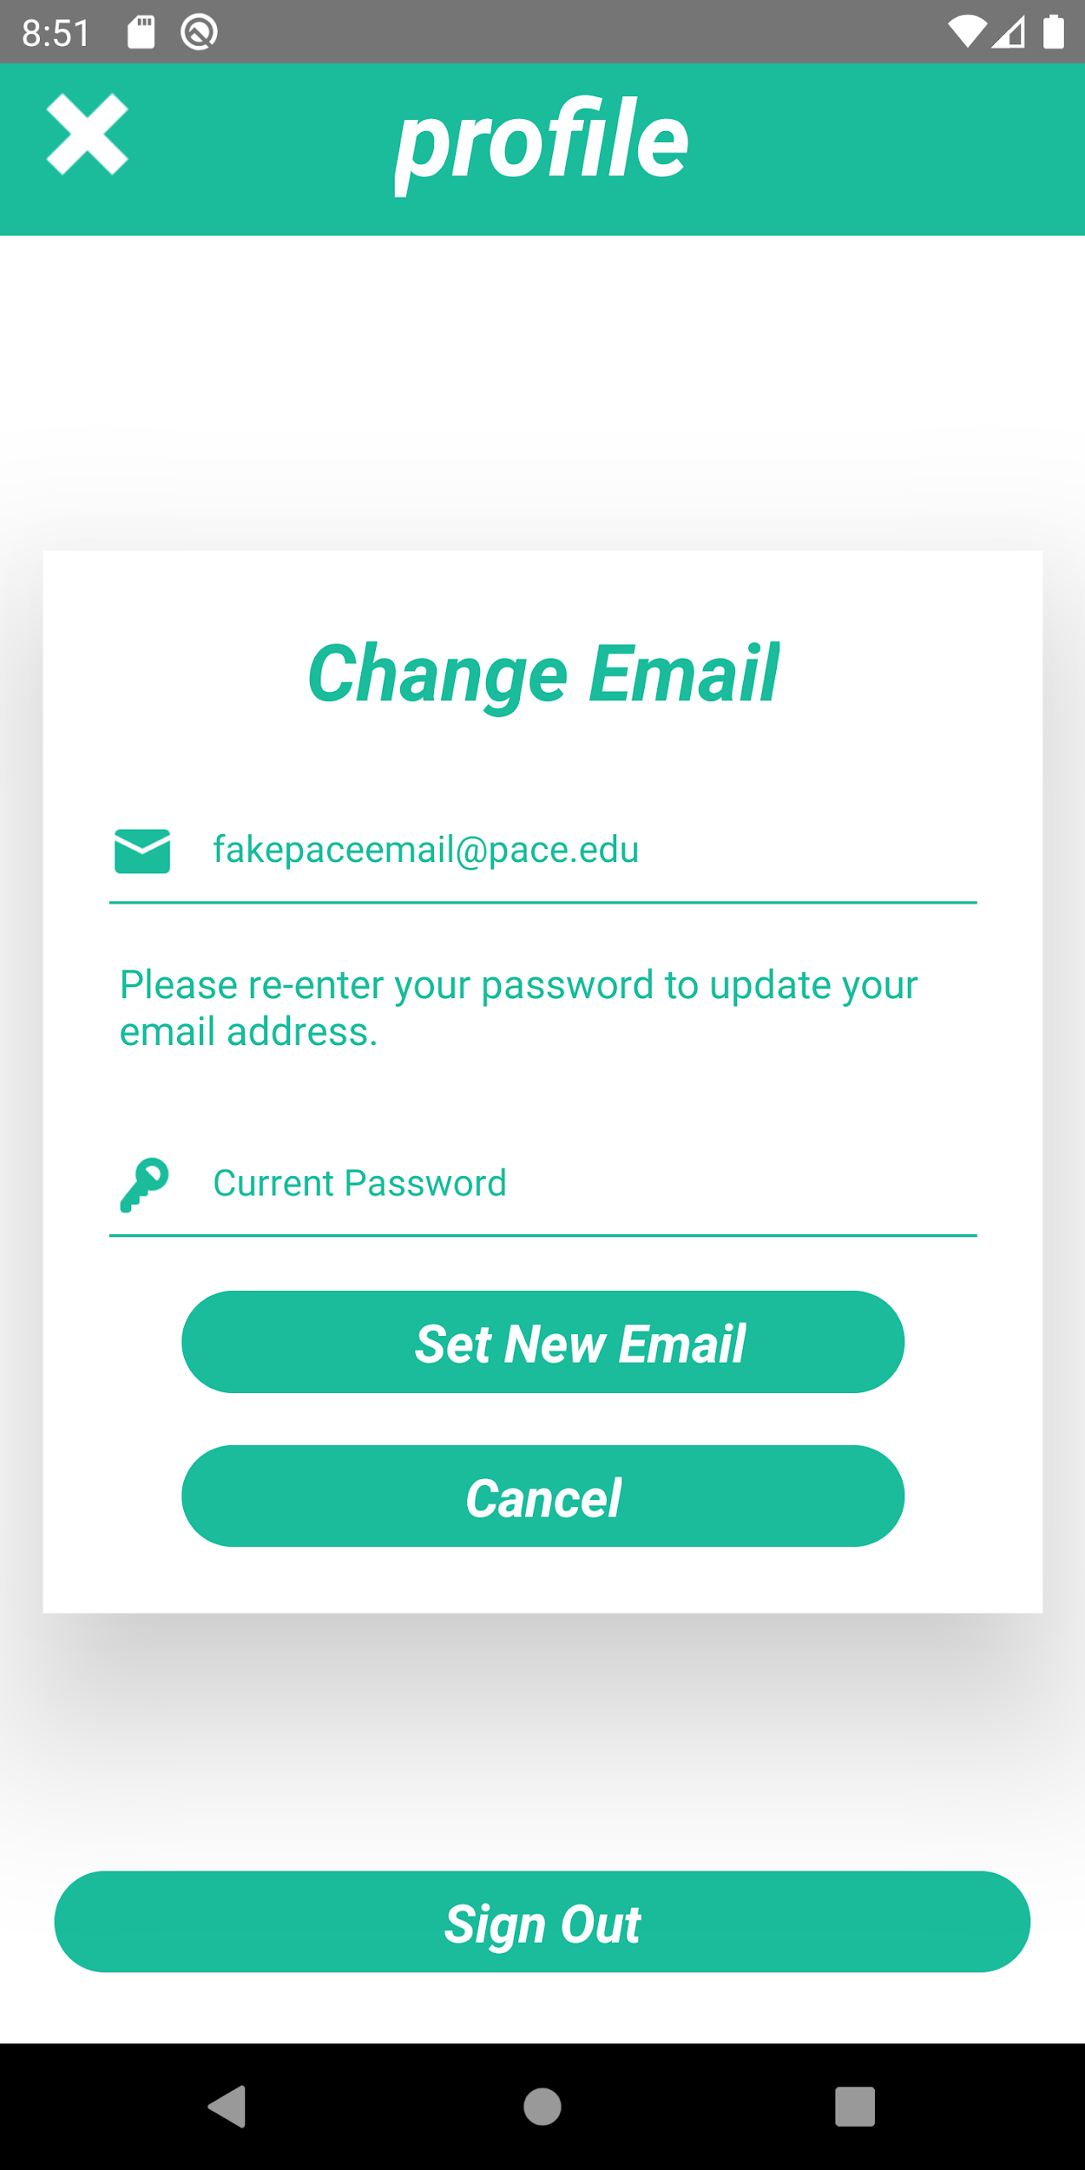
Screenshots

Slide 6
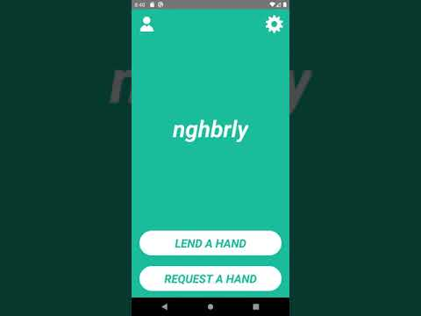
Demo

Slide 7
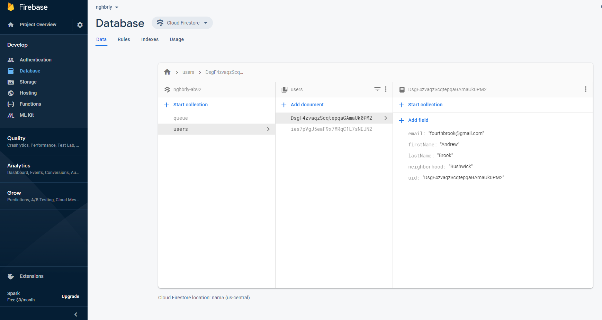
Database Screenshot

Slide 8
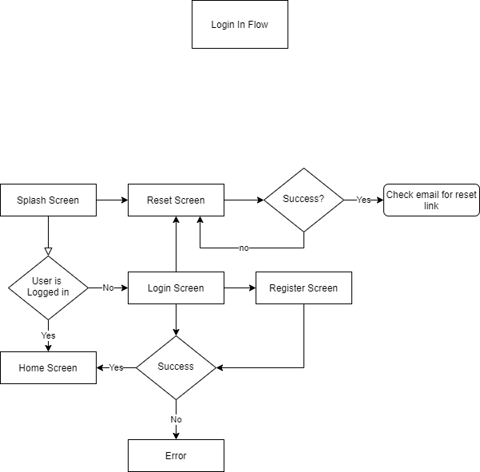
Login UML Diagram

Slide 9
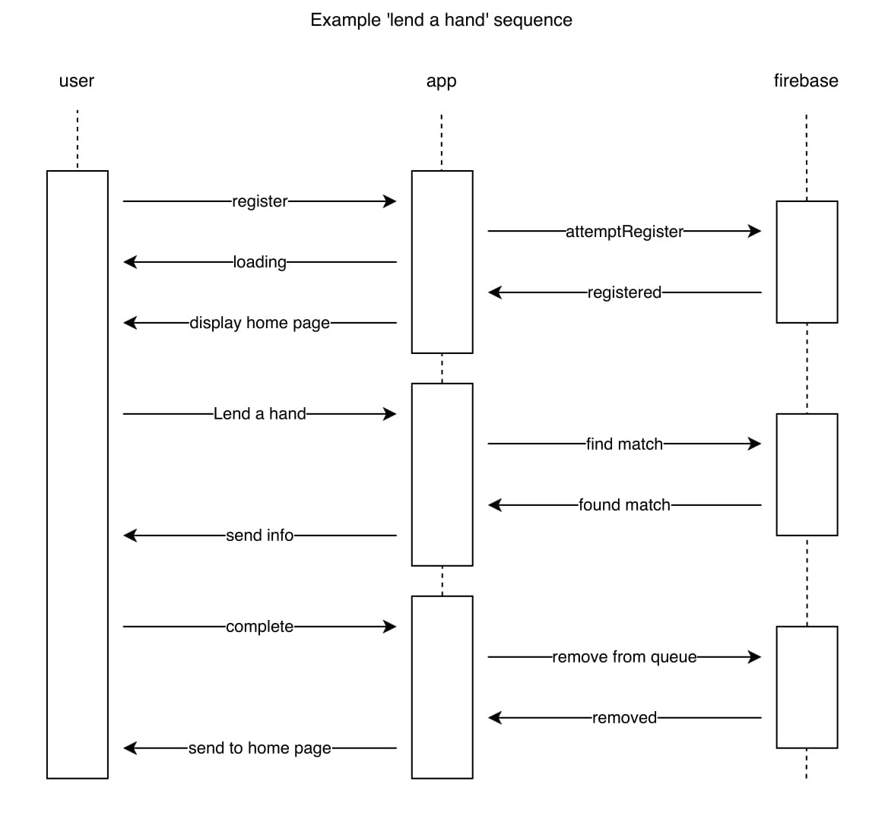
Sequence Diagram

Slide 10
Example Code
import React from 'react';
import {
StyleSheet,
View,
Image,
Text,
Dimensions,
TouchableHighlight,
} from 'react-native';
let deviceHeight = Dimensions.get('window').height;
let deviceWidth = Dimensions.get('window').width;
export default function Home({ navigation }) {
const profileHandler = () => {
navigation.navigate('Profile');
}
const settingsHandler = () => {
navigation.navigate('Settings');
}
return(
<View style={styles.container}>
<View style={styles.topMenu}>
<TouchableHighlight style={styles.profile}
activeOpacity={0.6}
underlayColor="#1ABC9C"
onPress={profileHandler}
>
<Image style={styles.profile}
source={require('../../images/icons/user.png')}
/>
</TouchableHighlight>
});
<TouchableHighlight style={styles.settings}
activeOpacity={0.6}
underlayColor="#1ABC9C"
onPress={settingsHandler}
>
<Image style={styles.settings}
source={require('../../images/icons/settings.png')}
/>
</TouchableHighlight>
</View>
<View style={styles.logo}>
<Text style={styles.logoText}>
nghbrly
</Text>
</View>
<View style={styles.buttons}>
<TouchableHighlight style={styles.button}
onPress={() => {
alert('Feature not yet implamented')
}}
>
<Text style={styles.buttonText}>
LEND A HAND
</Text>
</TouchableHighlight>
<TouchableHighlight style={styles.button}
onPress={() => {
alert('Feature not yet implamented')
}}
>
<Text style={styles.buttonText}>
REQUEST A HAND
</Text>
</TouchableHighlight>
</View>
</View>
)
}

Slide 11
Example Code
const styles = StyleSheet.create({
container: {
flex: 1,
backgroundColor: '#1ABC9C'
},
topMenu: {
flexDirection: 'row',
marginLeft: deviceWidth/30,
marginRight: deviceWidth/30,
height: deviceHeight/10,
justifyContent: 'space-between',
alignItems: 'center'
},
profile: {
height: deviceHeight/15,
width: deviceHeight/15,
},
settings: {
height: deviceHeight/15,
width: deviceHeight/15,
},
logo: {
height: 6*(deviceHeight/10),
justifyContent: 'center',
alignItems: 'center',
},
logoText: {
color: 'white',
fontStyle: 'italic',
fontWeight: '700',
fontSize: 60
},
buttons: {
height: 3*(deviceHeight/10),
paddingLeft: deviceWidth/20,
paddingRight: deviceWidth/20,
paddingTop: deviceWidth/20,
paddingBottom: deviceWidth/15,
justifyContent: 'space-around',
},
button:{
height: deviceHeight/12,
backgroundColor: 'white',
borderRadius: 50,
alignItems: 'center',
justifyContent: 'center'
},
buttonText:{
color: '#1ABC9C',
fontStyle: 'italic',
fontWeight: '700',
fontSize: 30
}

Slide 12
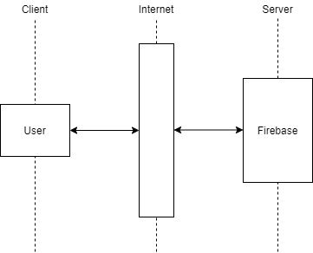
Client/Server Architecture

Slide 13
Testing
Interface Testing:
Usability Testing:
Unit Testing:
To test whether or not my app communicates with the firebase api correctly.
To test how easily users could accomplish tasks within the app.
Tested continuously as features were added to make sure each not feature worked properly and didn’t break any previous features.

Slide 14
Lessons Learned
Building an app on your own is more time consuming than you might think.
How to use react-native and its many components to build a working app.
How to use Google firebase to register users and store information.
How to install and utilize 3rd party react-native modules.
How to create an app with a specific function in mind.

Slide 15
References
React Native · A framework for building native apps using React. (n.d.). Retrieved May, 2020, from https://reactnative.dev/
Sommerville, I. (2019). Software engineering, tenth edition. Harlow: Pearson Education.
React Native Firebase. (n.d.). Retrieved May, 2020, from https://rnfirebase.io/

Slide 16
Link to GitHub
https://github.com/fourthbrook/Spring2020-SoftwareEngineeringProject

